Slide 1

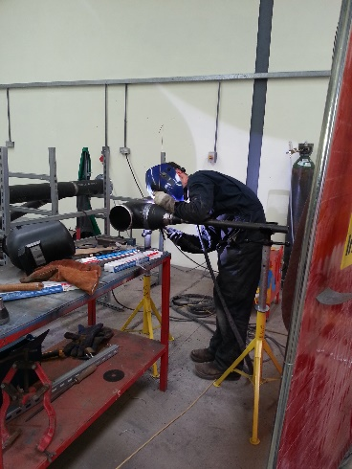
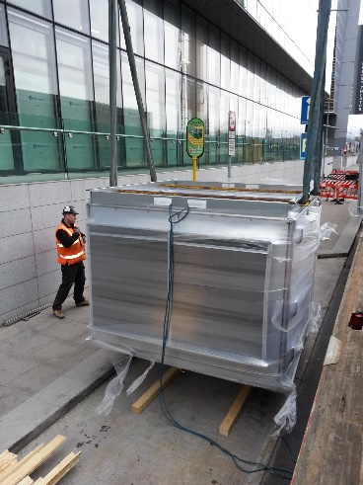
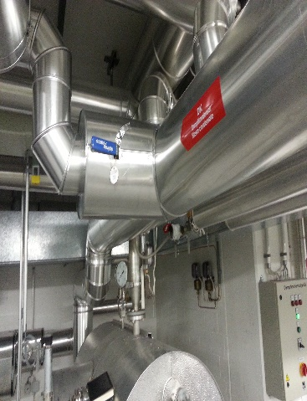
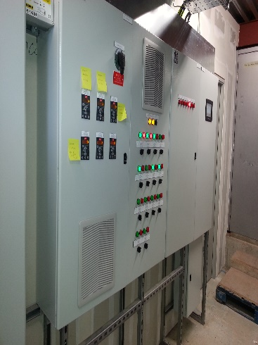
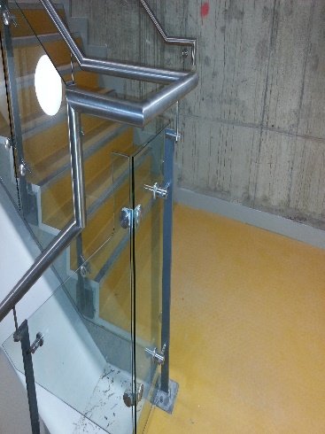
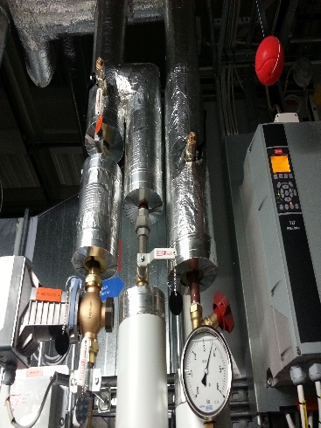
RMIS Engineering
At RMIS Engineering we specialise in Mechanical Engineering Contracting and Fabrication works to serve a wide range of industries in Carbon/Mild steel, stainless steel and Aluminium fabrication, pipework, welding and the provision of integrated engineering solutions.
We will design, manufacture and install on site, virtually all types of secondary fabrications in mild steel, stainless steel and aluminium.
Our strength lies in our ability to deliver the highest standards of QHSE required in highly regulated industry sectors including oil and gas.
We have a wealth of experience in providing a complete turnkey solution which can streamline demanding engineering projects for our clients, overseeing projects from start to finish with the services of a dedicated highly skilled workforce.
Our work is produced by skilled, time-served tradesmen including coded welders, platers and mechanical fitters. Our tradesmen are equally capable of operating from our fully-equipped fabrication workshop or on-site at client premises.
Our management team has backgrounds in fabrication, mechanical engineering and customer service delivery. With our midlands location and engineering heritage, our skills enable us to offer a high quality engineering service and an adaptable team.
We have been providing a first class service to industry for many years. We operate from our fabrication workshop in the town of Kilbeggan, County Westmeath in the centre of Ireland.
Moate Road, Kilbeggan, Co. Westmeath
Tel: 057 9333378 Email: info@rmis.ie

Slide 2

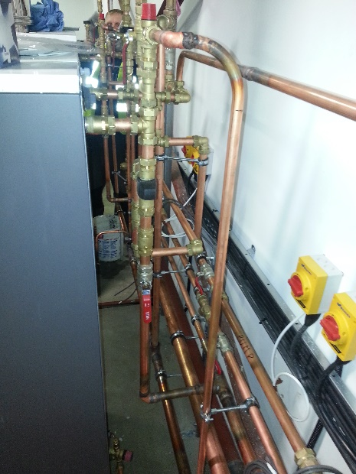
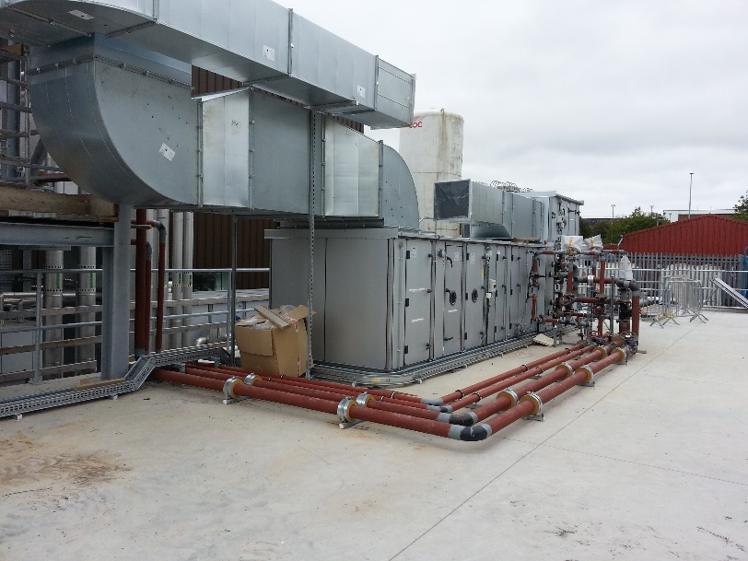
RMIS Engineering
Moate Road, Kilbeggan, Co. Westmeath
Tel: 057 9333378 Email: info@rmis.ie
Mechanical Services at RMIS
Our in house mechanical team provide installation and maintenance services across a wide range of assets covered under hard facilities management.
Piped services
Heating Ventilation and Air Conditioning
Plant and Machinery Installation & Maintenance
Ventilation and Extraction systems
Diagnostic Repairs
Compressors
Gas and Heating Systems
Test and Inspection

Slide 3

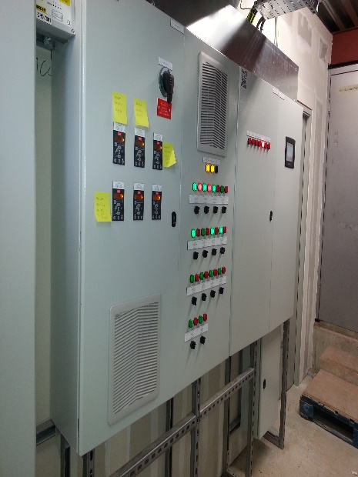
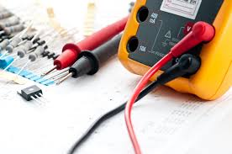
RMIS Engineering
Moate Road, Kilbeggan, Co. Westmeath
Tel: 057 9333378 Email: info@rmis.ie
Electrical Services at RMIS
We provide installation and maintenance services, supervised by our qualified electrical management team and carried out by our time served electricians:
Installations
Energy Efficient Lighting
Control Systems

Slide 4

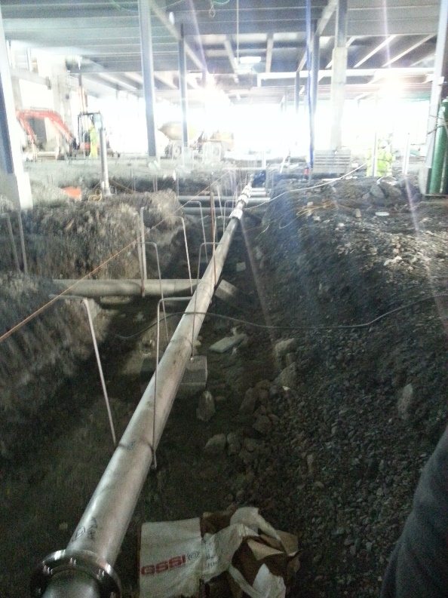
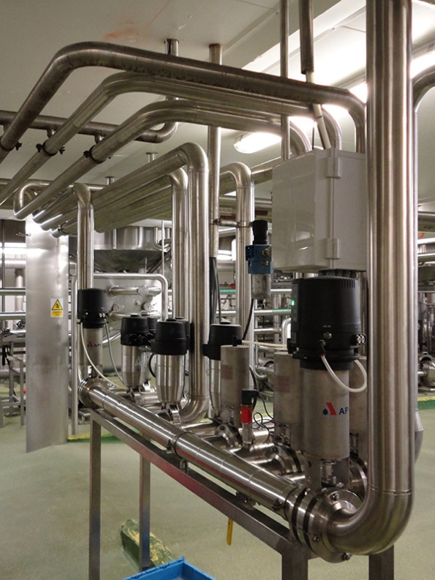
RMIS Engineering
Moate Road, Kilbeggan, Co. Westmeath
Tel: 057 9333378 Email: info@rmis.ie
Refurbishment Services at RMIS
Our experienced project management team provides a one-stop solution for building upgrades and improvements within working environments such as production facilities, offices, and reception areas:
Project Management
Heating, Ventilating and Air Conditioning
Power and Lighting
Plumbing

Slide 5

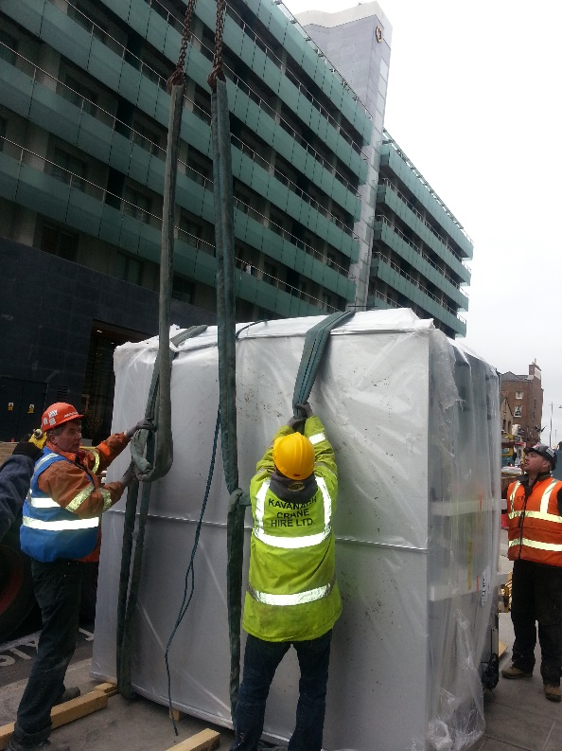
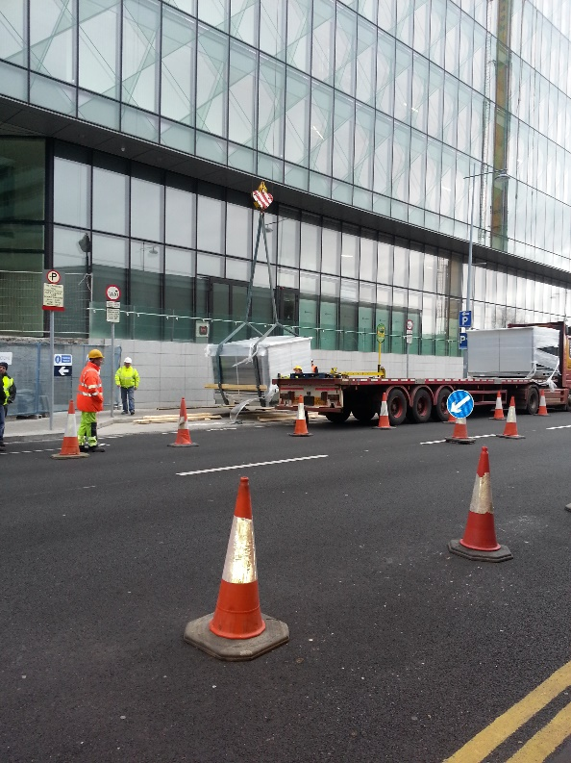
RMIS Engineering
Moate Road, Kilbeggan, Co. Westmeath
Tel: 057 9333378 Email: info@rmis.ie
Industrial Relocation Services at RMIS
Our specialist relocation team are experienced in the relocation of heavy plant and production machinery, as well as production lines and complete manufacturing facilities:
Project management
Decommissioning
Transportation
Installation

Slide 6
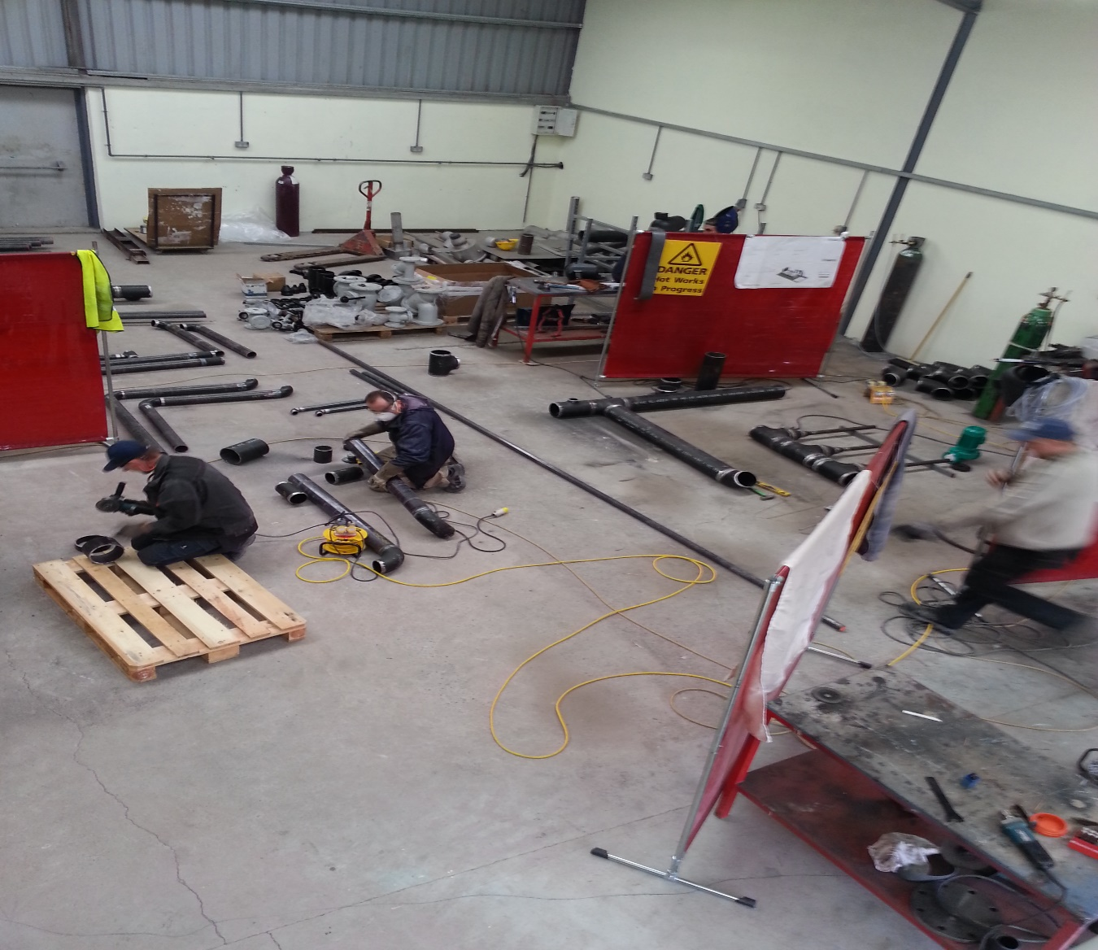

RMIS Engineering
Moate Road, Kilbeggan, Co. Westmeath
Tel: 057 9333378 Email: info@rmis.ie
Our Workshop
At our workshop we can provide
Stainless Steel Fabrication
Mild Steel Fabrication
Aluminium Fabrication
Prefabrication piping

Slide 7
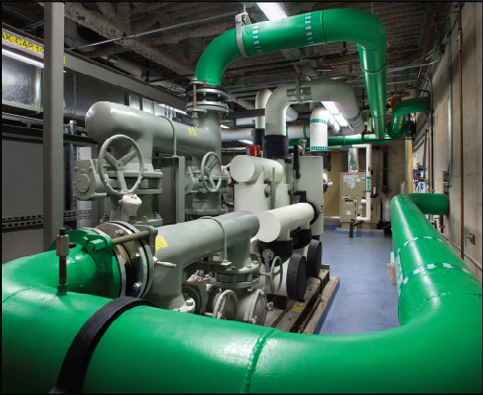
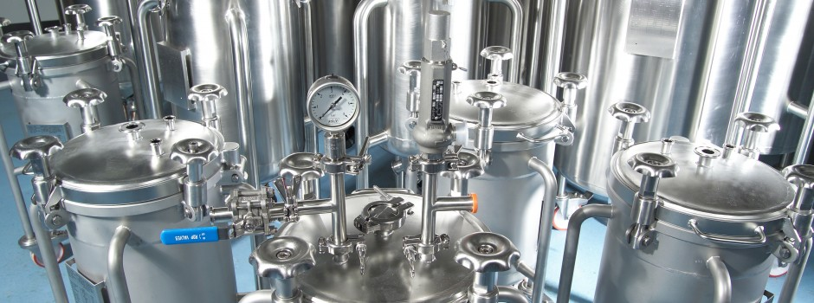
RMIS Engineering
Moate Road, Kilbeggan, Co. Westmeath
Tel: 057 9333378 Email: info@rmis.ie
How to contact us
Email us on info@rmis.ie
Call us on 057 9333378
Visit us at www.rmis.ie

